Slide 1
An Alternative Investigation into Country-Wide Happiness
By: Vee Kalkunte

Slide 2
What Makes People Happy?
Notes:
This is the question upon which this project is centered: What makes people happy?
A common question, and one that’s been researched throughout many disciplines. This project, however, chooses to approach this question in a macro perspective, using country-wide statistics from the World Happiness Report as well as the World Bank datasets.

Slide 3
Leading Study: The World Happiness Report
Funded by the United Nations
Measures self-reported happiness and factors that may affect it
Focuses on:
Economics
Family (Fertility rate, etc.)
Health (Life Expectancy, etc.)
Freedom
Trust in Government
Generosity

Slide 4
A Different Focus:
Consider Population Density: “Some Social Implications of Higher Density Housing” Robert Edward Mitchell
Consider Urban Population Percentages: “An Urban-Rural Happiness Gradient” Brian Berry
Consider Climate: “Does Climate Undermine Subjective Well-being? A 58 Nation Study” by Ronald Fischer and Evert Van de Vliert

Slide 5
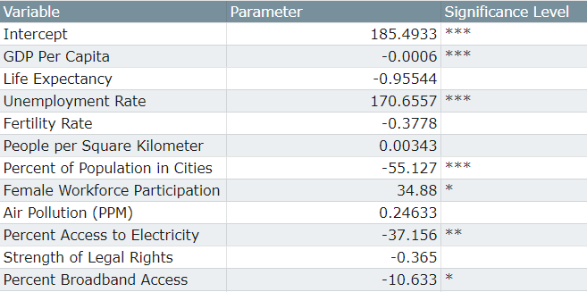
Predicting Happiness Ranking: Model #1
Adjusted R-Squared Value: 78.50%
*** as most significant, ** as highly significant, and * as statistically significant
Notes:
ADD R^2
Get rid of SE, P value columns, keep asterix

Slide 6
The Original Regression Had Diagnostic Issues

Slide 7
Issues Tested for:
Multicollinearity -- The variables move together
Autocorrelation --The past observations influence the future ones
Heteroskedasticity -- Our variances were not consistent
Omitted Variable Bias -- Missing a variable that both affects the dependent and an independent variable

Slide 8
Problem 1: Multicollinearity
This is when variables influence each other, thus making the strength and significance unreliable, or biased
Life Expectancy, Fertility Rate, & Electricity Access are correlated
By testing various models: we chose to drop Electricity Access
Protect the high R-squared percentage
Preserve quality of life metrics
The remaining variables are still significant

Slide 9
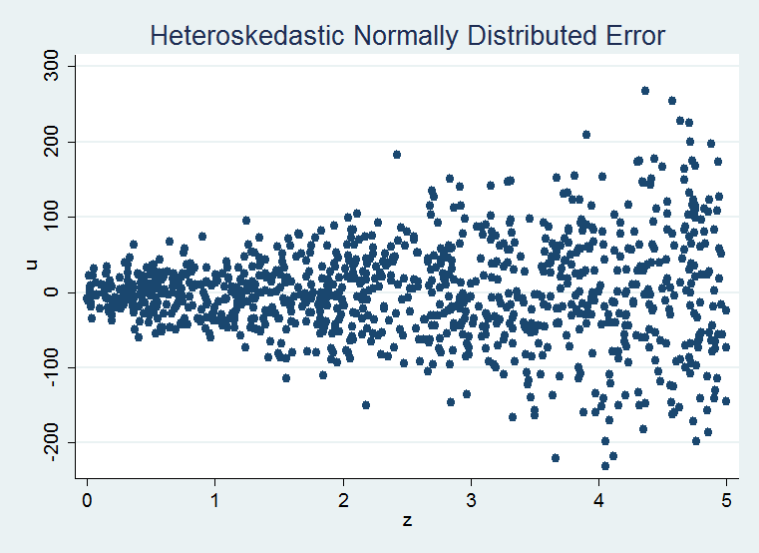
Problem 2: Heteroskedasticity
The variation of observations is not consistent
Our predictions are no longer the best
Test for it: Goldfield-Quant Test
Correction for it: widen the margins of errors, creating robust standard errors

Slide 10
138 countries,
8 variables
GDP Per Capita
Life Expectancy
Unemployment Rate
Female Workforce Participation Rate
People per Square Kilometers
Fertility Rate
Percent Population in Cities
Air Pollution (PPM)

Slide 11
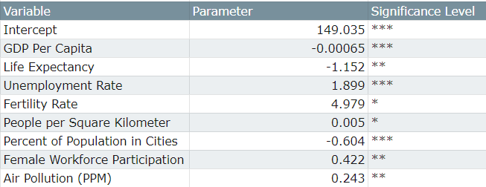
Predicting Happiness Ranking:Model #2
Adjusted R-Squared Value: 75.06%
Happiness Ranking = GDP per Capita + Life Expectancy + Unemployment Rate + Percent Population in Cities + People per square kilometer + Fertility Rate + Female Workforce Participation + Air Pollution
*** as most significant, ** as highly significant, and * as statistically significant
Notes:
ADD R^2

Slide 12
Major Takeaways:
Economic factors were the strongest
Population density and urban population are important
Strength of Legal Rights was not a significant variable
Pollution is significant to happiness

Slide 13
Policy Implications
Improving economic conditions matters.
With the significance of population density, we should consider city development, zoning laws from the lens of happiness
Climate and pollution policies can be looked at through this lens of happiness

Slide 14
Notes for Further Improvement
Find better indicator variables for measuring citizen-government relationships.
Consider looking for the following groups of variables (in such a way that one can compare across countries):
Weather and Climate influencers
Mental health facilities and other health infrastructure
Crime rates (measured similarly across countries)

Slide 15
“Of the blessings set before you make your choice, and be content. No man can taste the fruits of autumn while he is delighting his scent with the flowers of the spring: no man can, at the same time, fill his cup from the source and from the mouth of the Nile.”
― Samuel Johnson, The History of Rasselas, Prince of Abissinia
Notes:
We study happiness so that we know how to make the best of what time and resources we have, to improve the lives of the community around us.

Slide 16
Citations:
Mitchell, Robert Edward. “Some Social Implications of High Density Housing.” American Sociological Review, vol. 36, no. 1, Feb. 1971, pp. 18–29., doi:10.2307/2093503.
Helliwell, John F. “Home.” World Happiness Report 2019, United Nations, 20 Mar. 2019, worldhappiness.report/.
Suzuki, Emi, et al. “World Bank Open Data.” Data, World Bank, 26 Nov. 2019, data.worldbank.org/.
Berry, Brian J. L., and Adam Okulicz-Kozaryn. “An Urban-Rural Happiness Gradient.” Urban Geography, vol. 32, no. 6, 2011, pp. 871–883., doi:10.2747/0272-3638.32.6.871.
Fischer, Ronald, and Evert Van De Vliert. “Does Climate Undermine Subjective Well-Being? A 58-Nation Study.” Personality and Social Psychology Bulletin, vol. 37, no. 8, 2011, pp. 1031–1041., doi:10.1177/0146167211407075.
All rankings are from the World Happiness Report (2017) and all independent variables are from the World Bank Databank (2017)

